Slide 1
Dimensionality Reduction

Slide 2
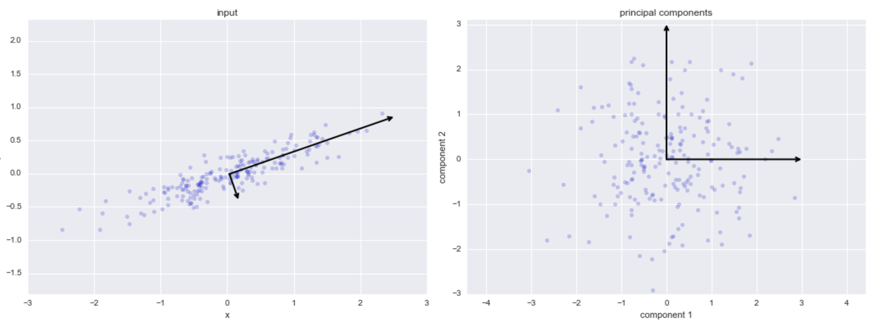
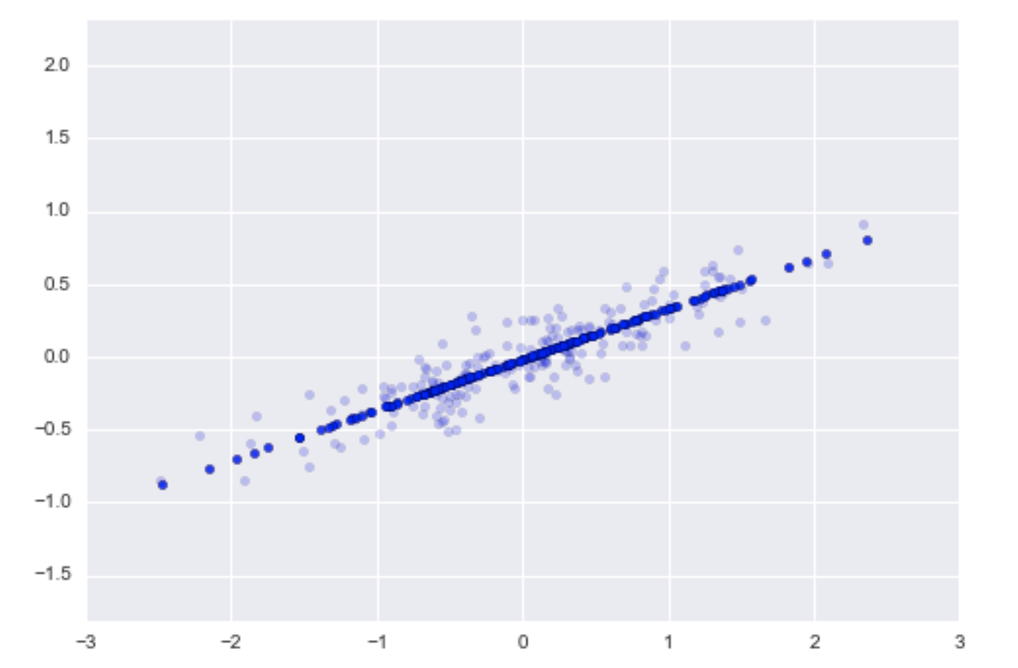
Example PCA plots
https://jakevdp.github.io/PythonDataScienceHandbook/05.09-principal-component-analysis.html

Slide 3
Principal components 1 and 2 with energy

Slide 4
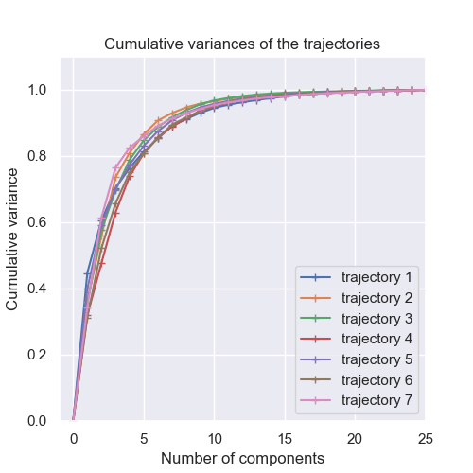

Slide 5
Principal components of individual trajectories
Principal components of combined trajectories

Slide 6
Component 1

Slide 7
Component 1

Slide 8
Component 4

